Slide 1
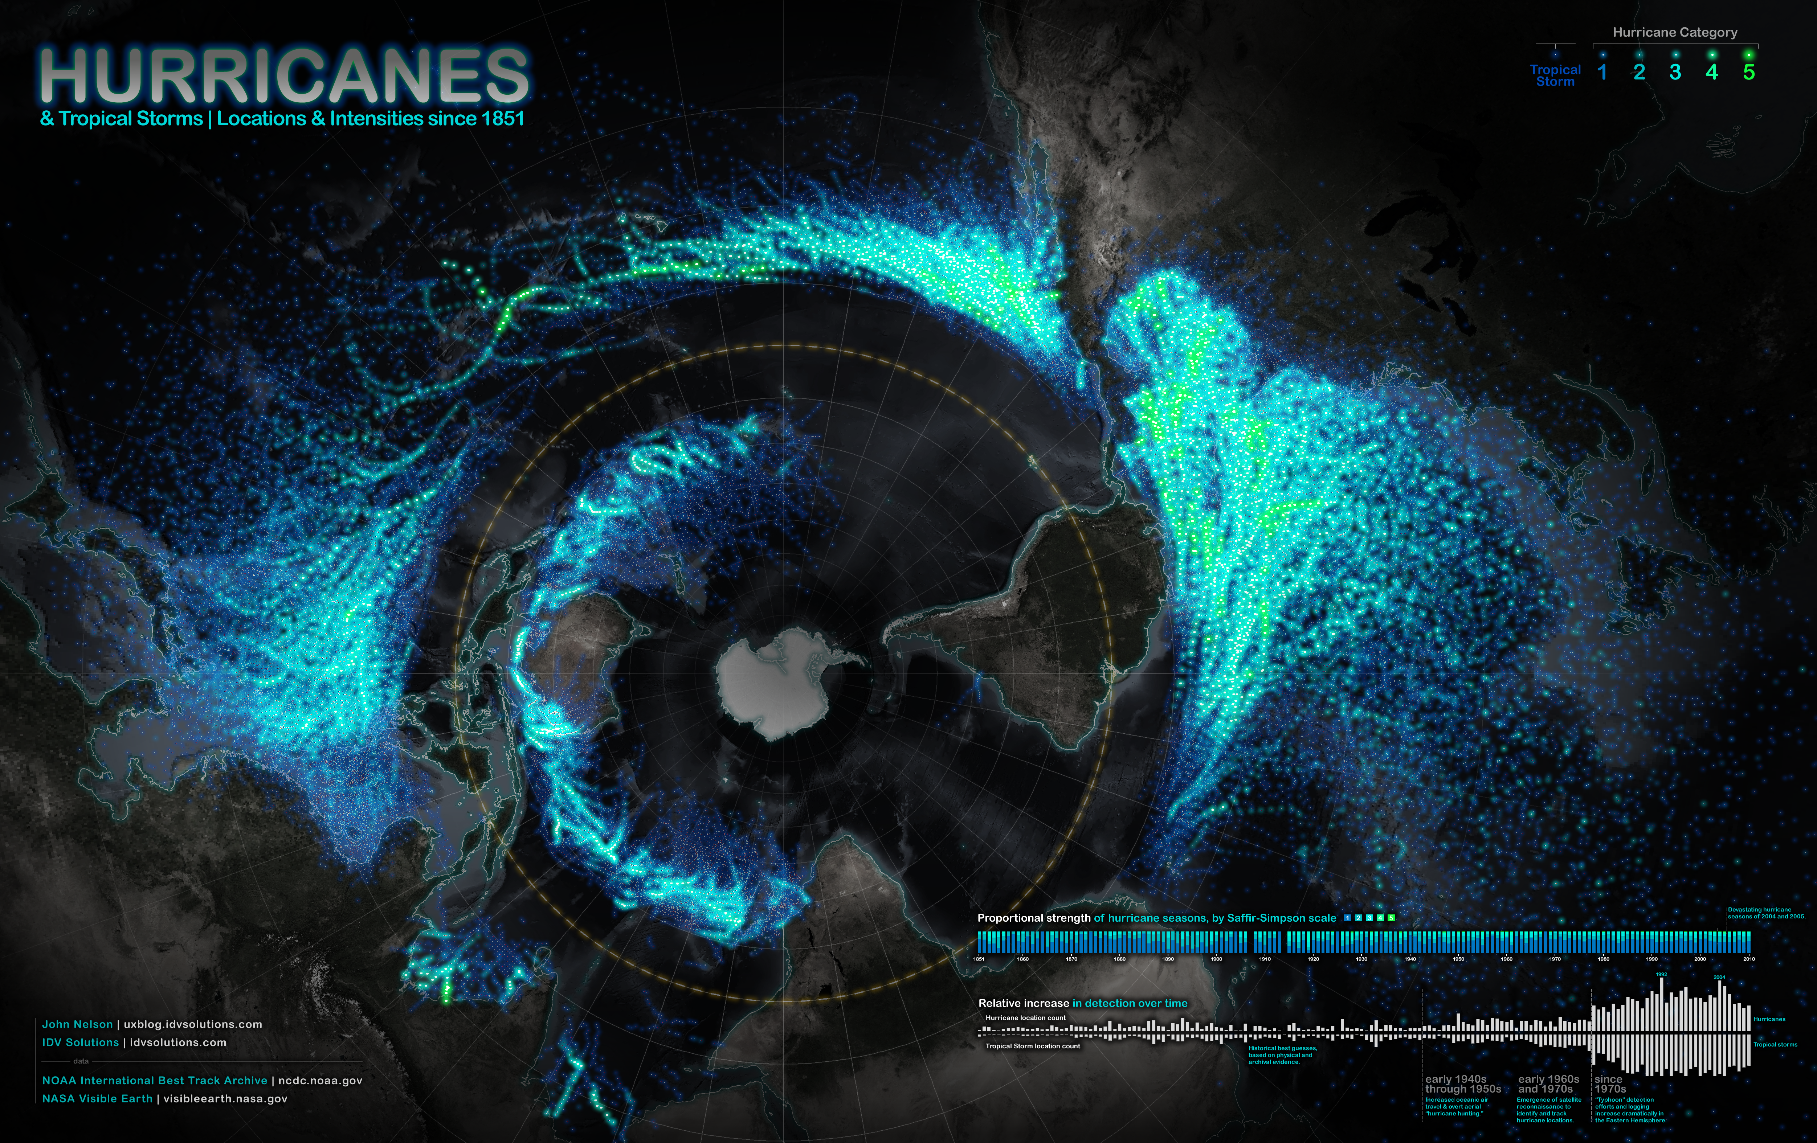

Slide 2
Intermediate GIS
GEOG 558
Jim Coll

Slide 3
Plan for this week
Tuesday:
Introduce ourselves
Cover an example of spatial analysis
Cover course outline and expectations
Thursday:
GIS Refresher

Slide 4
Instructor and Teaching Assistant

Slide 5
My Background
Applications of GIS in Hydrology and Environmental science
B.S. In Environmental Science and Policy from Plymouth State University
M.S. In Environmental Science from KU
Operational Cartography
Big Data Remote Sensing (Google Earth Engine)
National Water Model

Slide 6
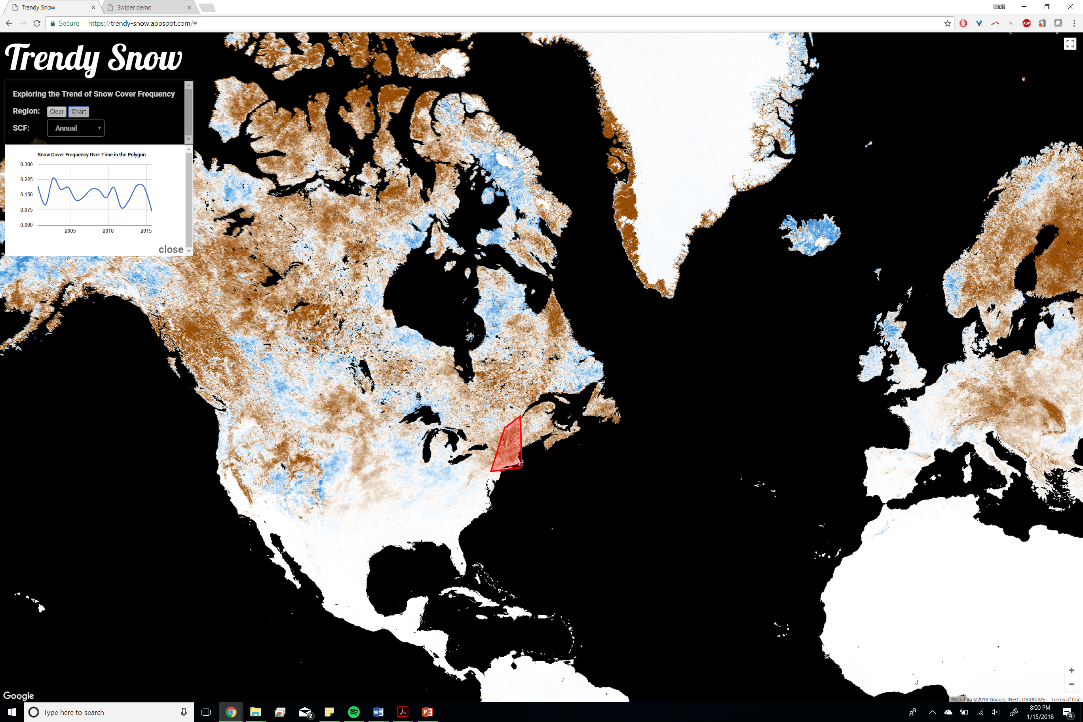

Slide 7
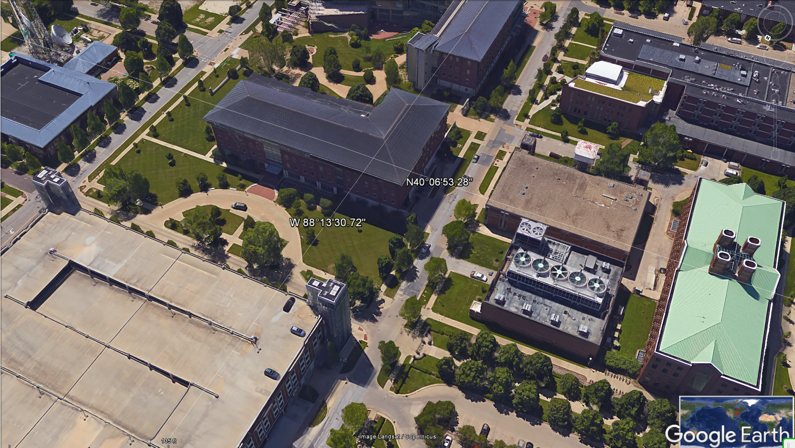
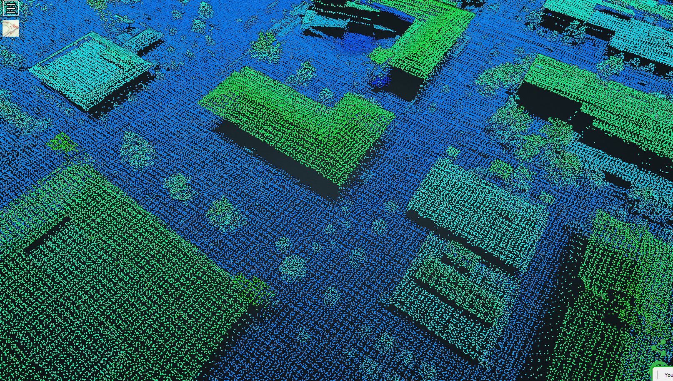

University of Illinois Urbana-Champaign
UIUC LIDAR
Point Cloud

Slide 8
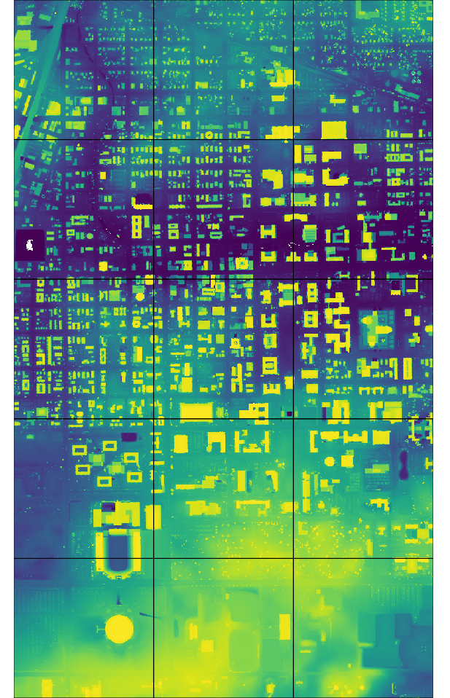
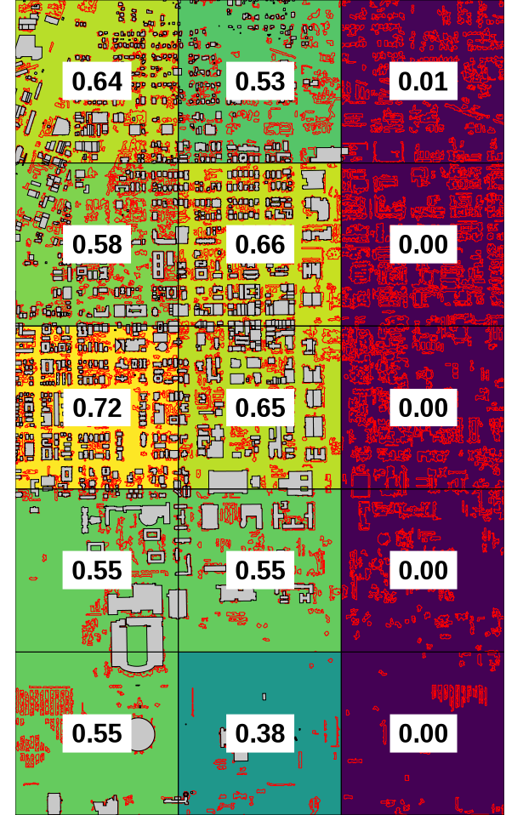
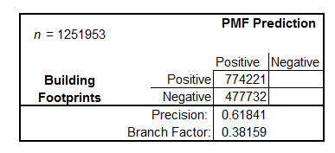
UIUC Results
1. 2.
Last returns
Regional (per tile) accuracies
No validation data for the righthand tiles

Slide 9
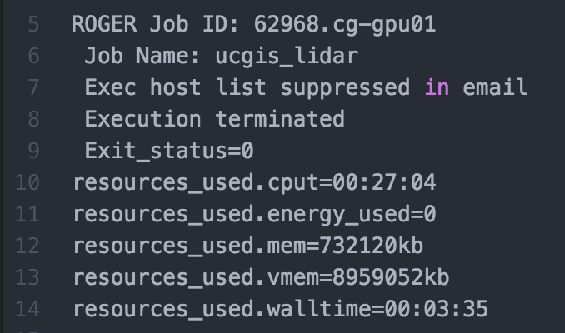
UIUC HPC Results
Traditional processing time: 27 minutes
HPC processing time : 3 minutes

Slide 10
UIUC vs. Jean-Lafitte
UIUC – Marginal improvement from a traditional computing paradigm to HPC
15 tiles
Jean-Lafitte – Substantial improvement from a traditional computing paradigm to HPC
125 tiles

Slide 11
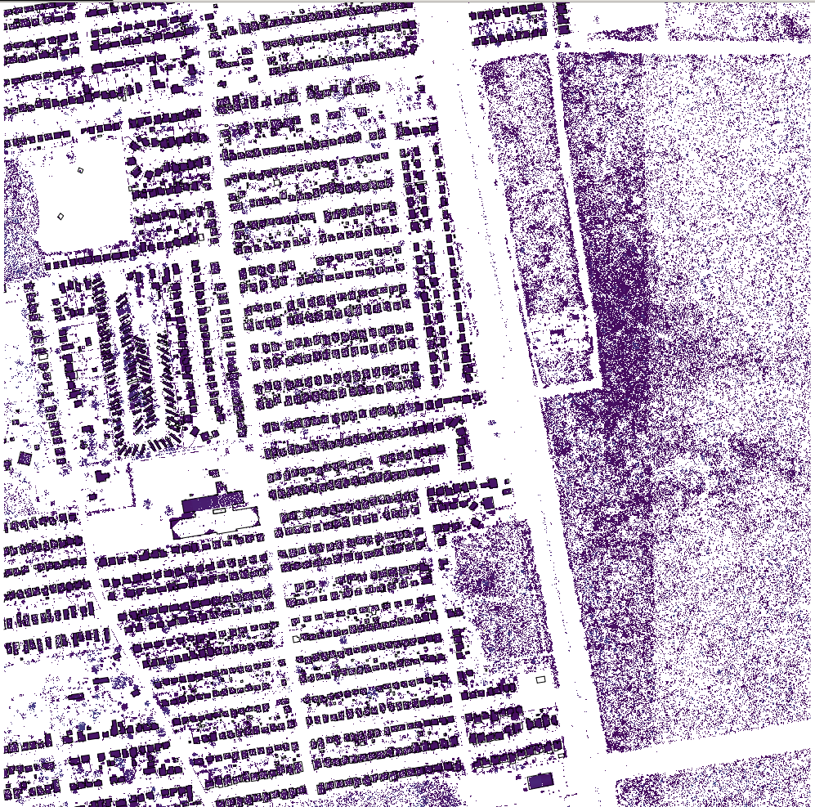
Jean-Lafitte PMF Results
Low precision globally
Low building presence in bayou
Poor PMF performance introduces false positives

Slide 12
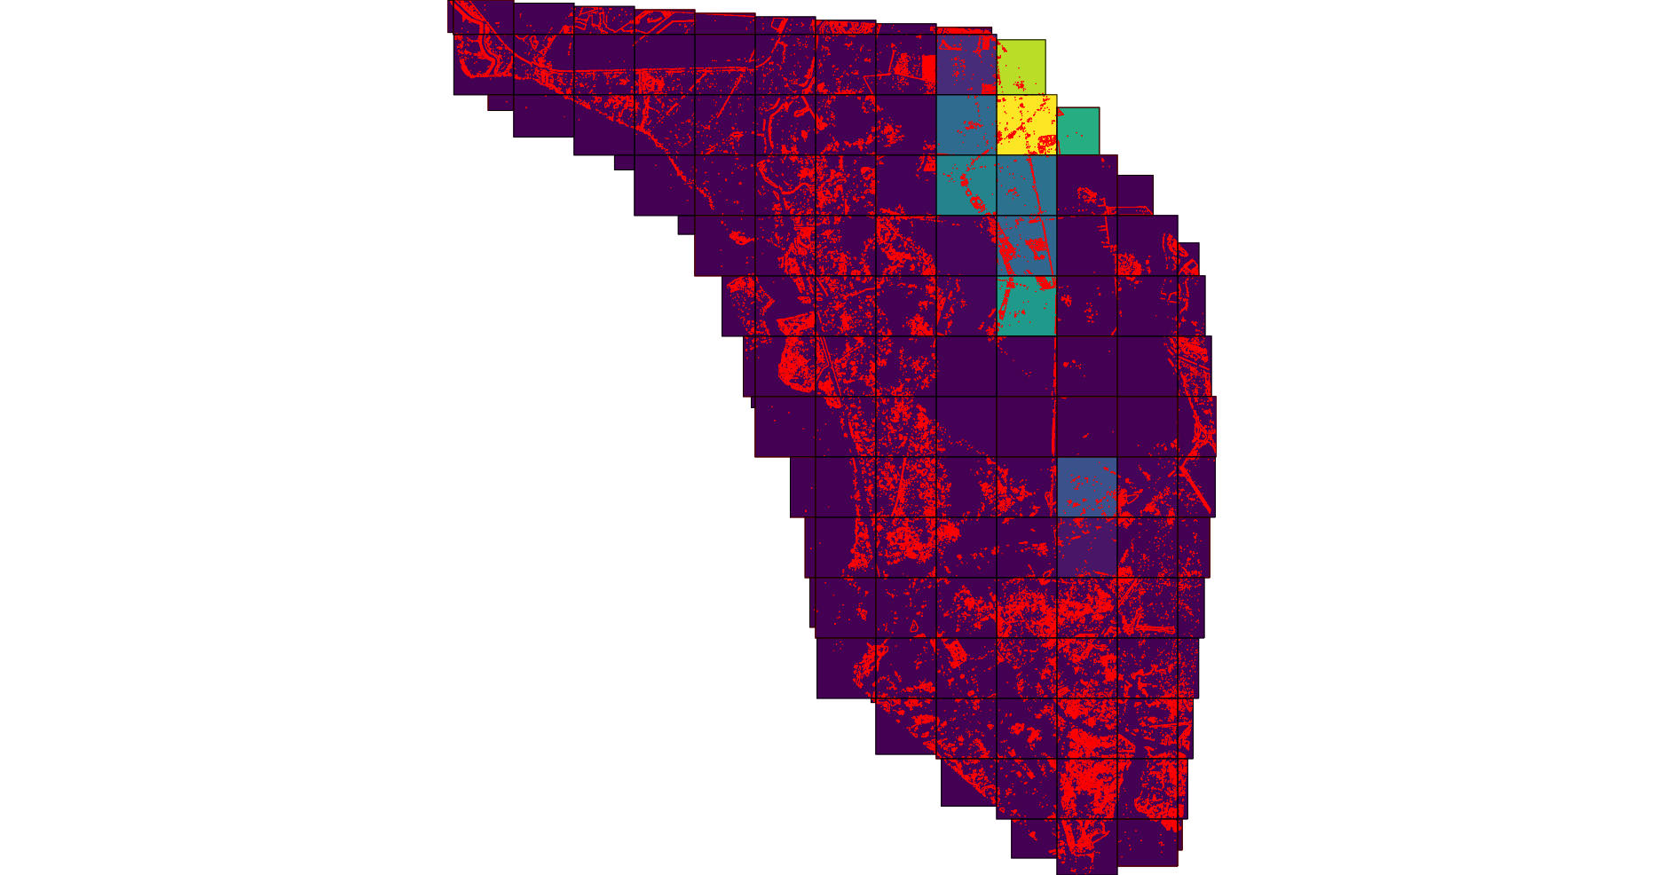
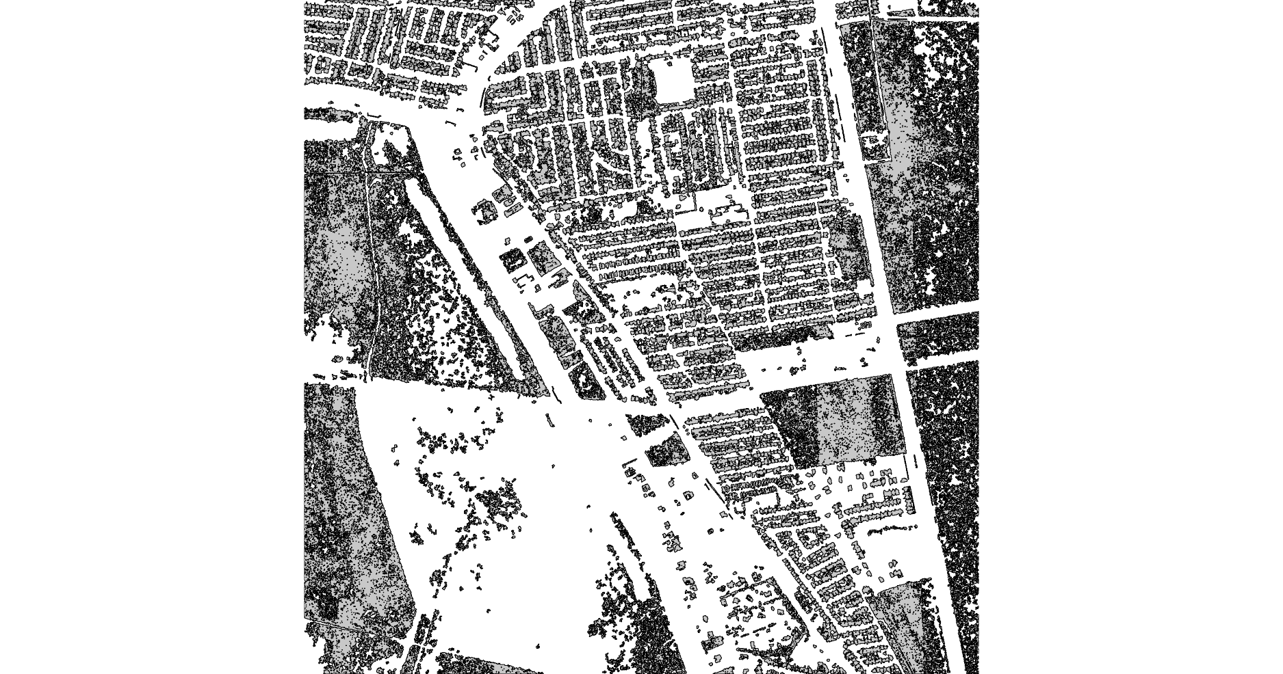
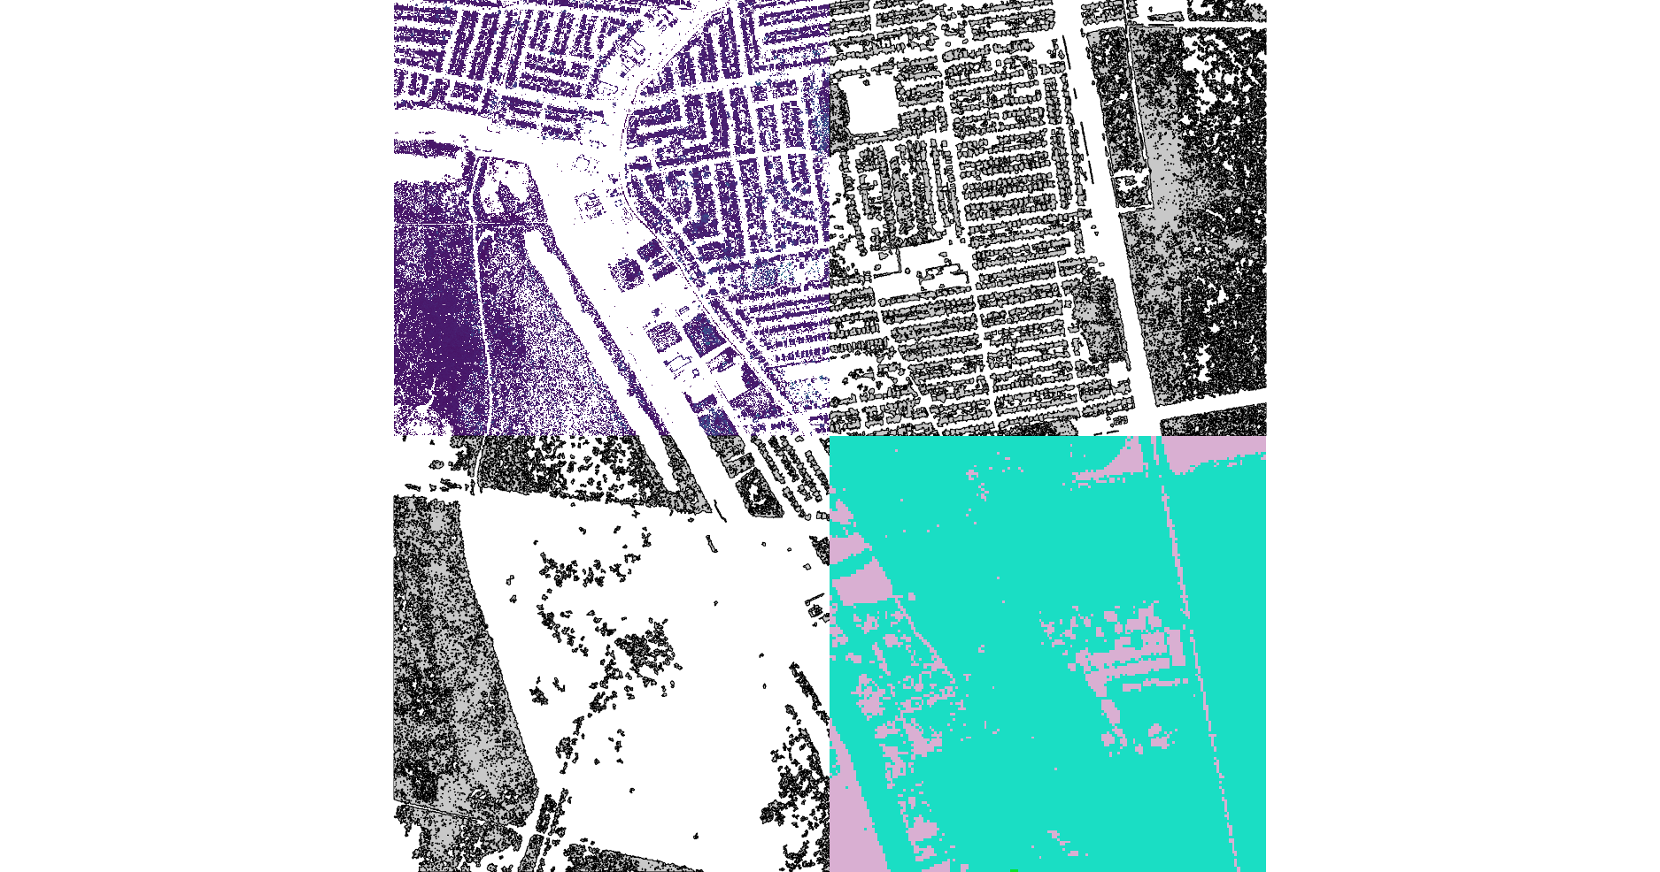
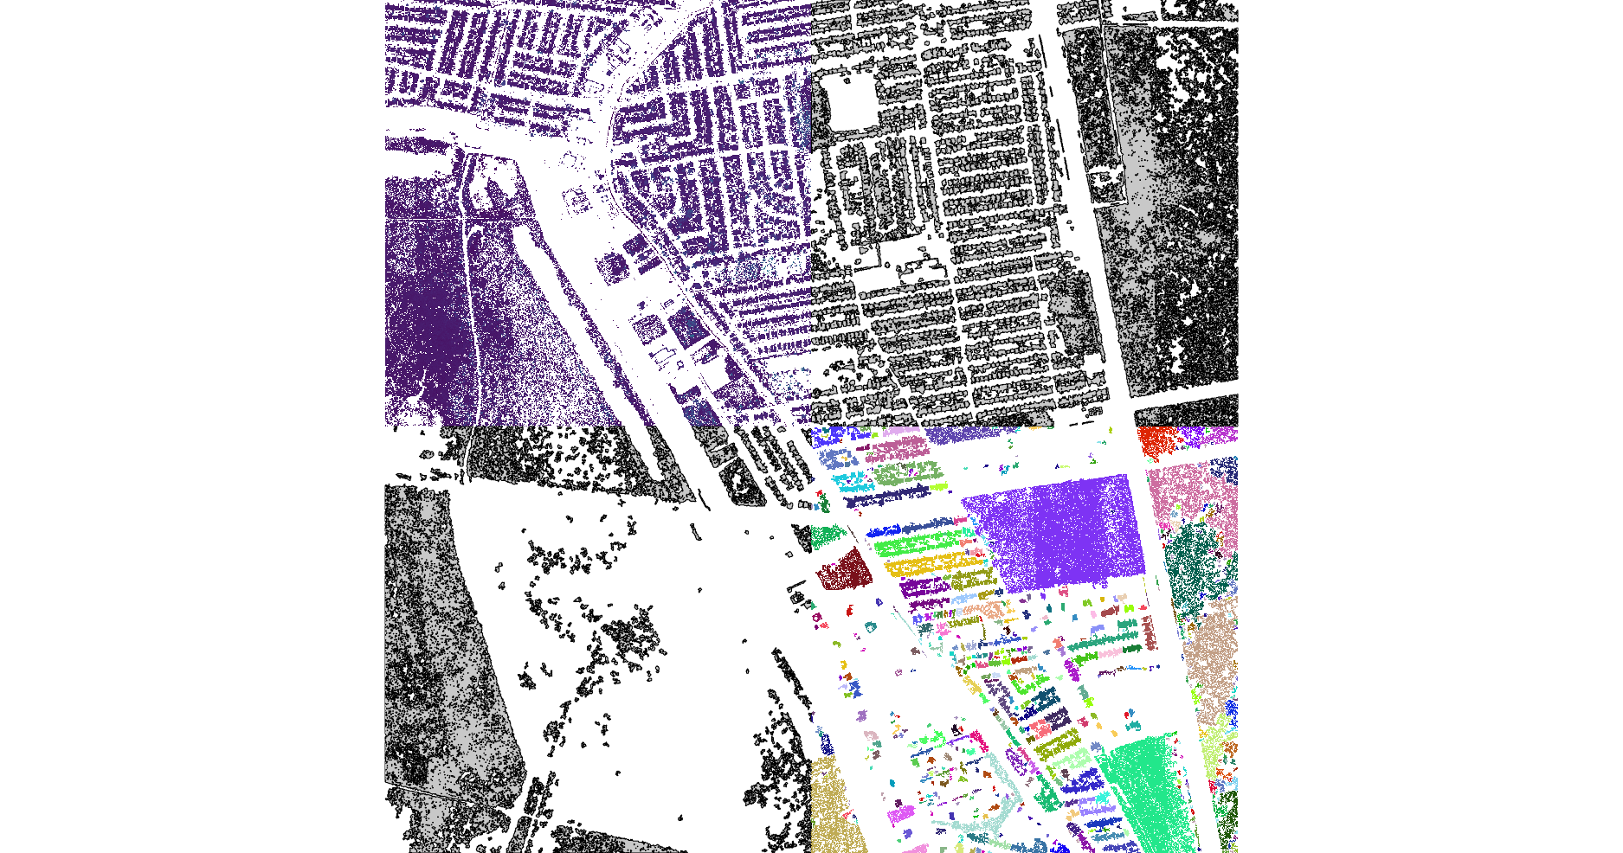
Jean-Lafitte Results

Slide 13
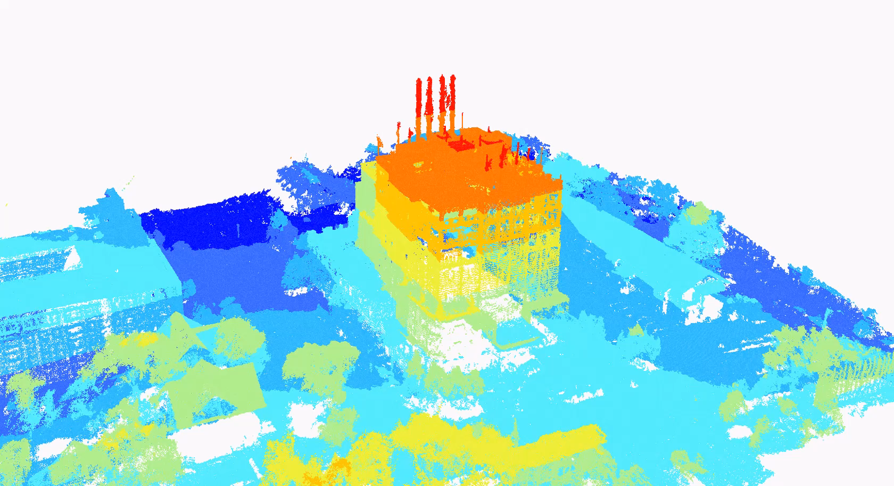


Slide 14
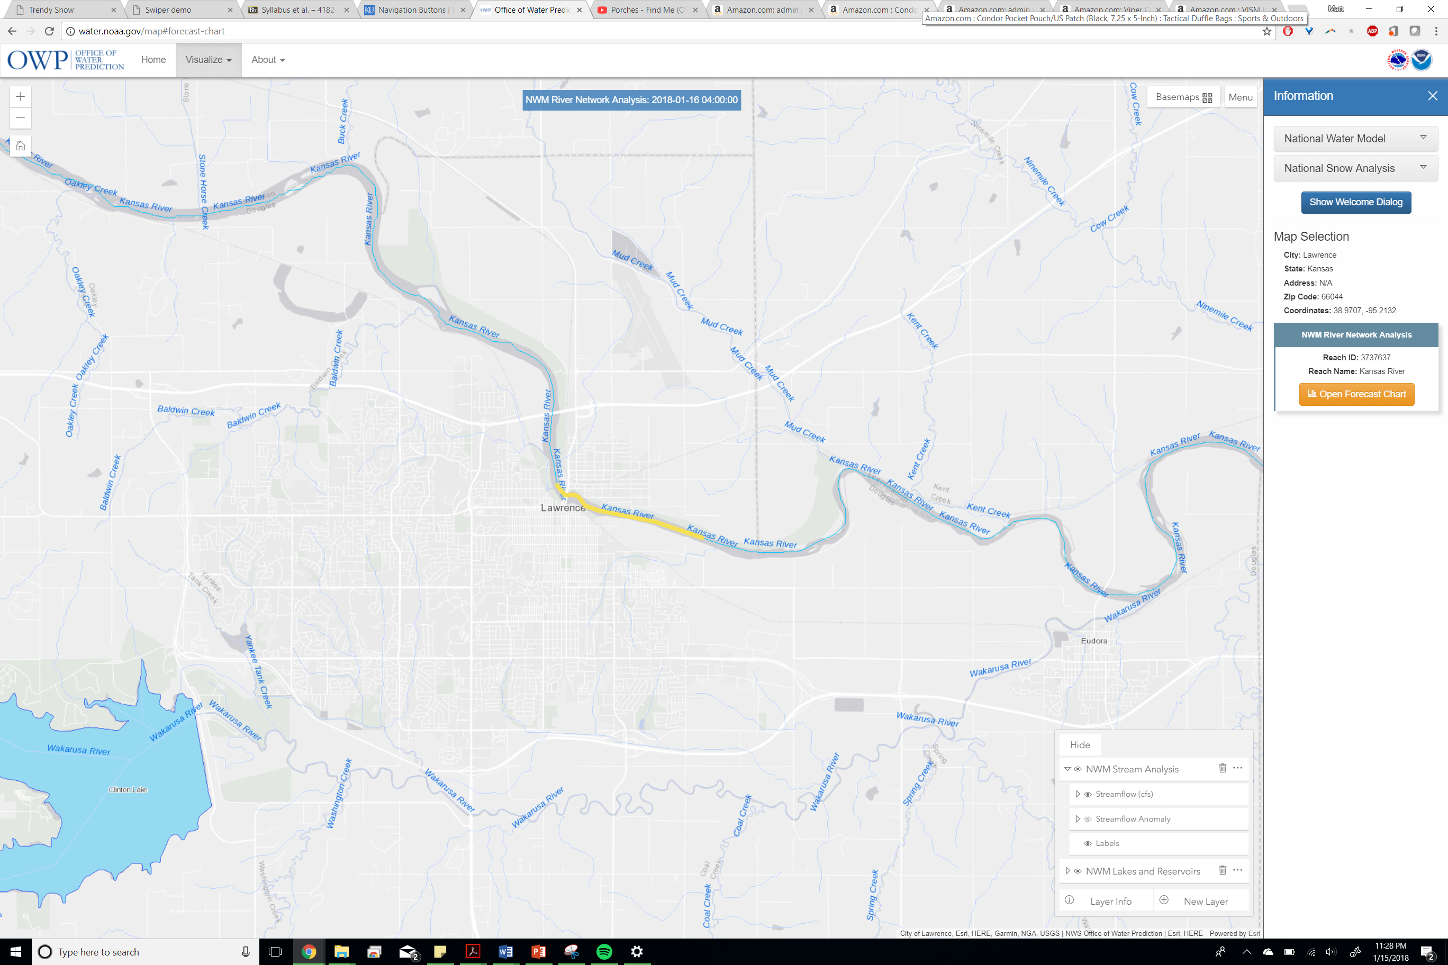

Slide 15
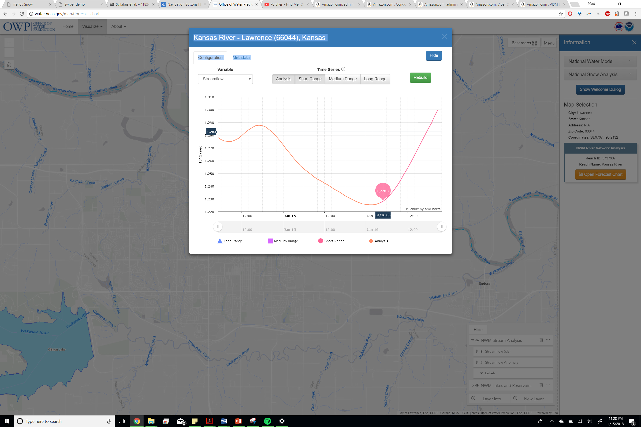

Slide 16
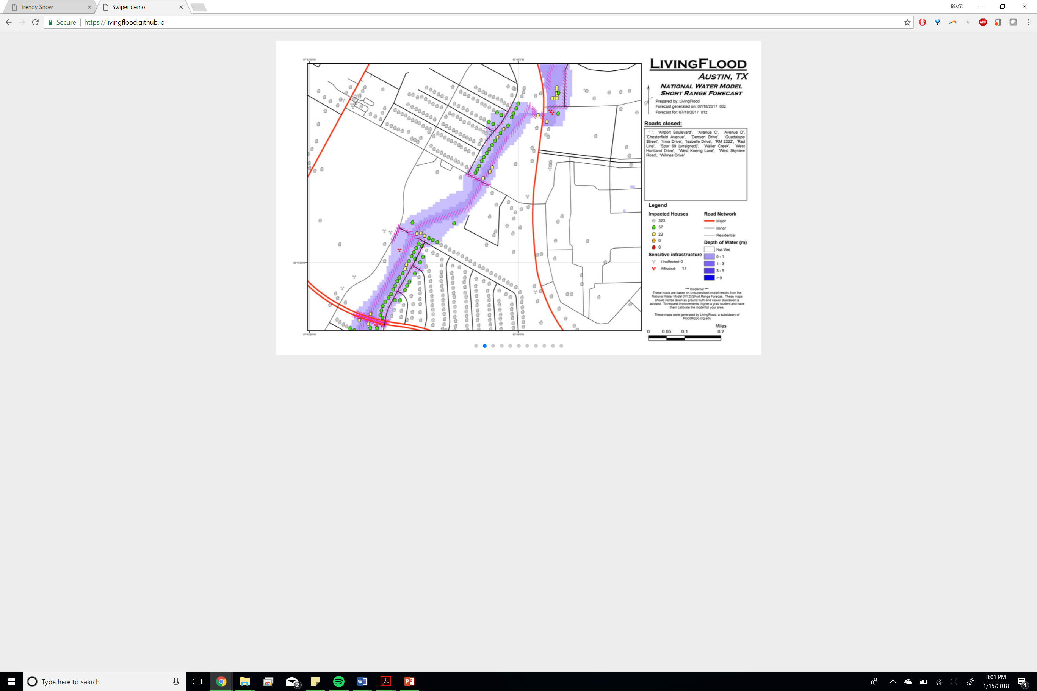

Slide 17

Introduce yourselves
Name
Major (and level)
Previous GIS experience
Reason for taking the class
Favorite Color

Slide 18
Lectures & Labs
Lectures
Tuesday: 11-12:15
Thursday: 11-12:15
Classroom: Lindley 228
Labs
Monday: 1:00-2:50
Wednesday: 11-12:50
Lab Room: Lindley 310
(Door code is 1234)

Slide 19
Course Objectives
Primarily focus on spatial analysis methods and tools for vector and raster data
Data and mapping techniques
Map algebra/cartographic modeling
Geoprocessing in ArcGIS
Spatial optimization
Terrain analysis
Spatial statistics
Spatial prediction
Hands on GIS software experience
ArcGIS 10.5
ArcGIS Pro
QGIS
Spatial cognitive skills
Mapping and spatial variation
Linking data to location
Location is everywhere
Exploring spatial relationships

Slide 20
Prerequisites and textbook
Prerequisites
Intro course in GIS such as GEOG 358
Experience with ArcGIS
Required Textbook
de Smith, M. J., M. F. Goodchild, P. A. Longley (2012) Geospatial Analysis—A comprehensive guide (4rd edition),
An online version is available at http://www.spatialanalysisonline.com/HTML/index.html

Slide 21

ArcGIS & Slack
https://docs.google.com/spreadsheets/d/1RTPhUiCE5RQFGIFa5iEX6kz4MWgEweVldInDvnJQNVg/edit?usp=sharing

Slide 22
Grading
7 point scale
Midterm exam – Week of May 5th -20%
Final exam – week of may 7th - 20%
Labs - -40%
Final Project – Last week of class -20%
(intermediates are 10% / paper is worth 65% / Presentation is worth 25%)
Proposal (1 ~ 3 pages, due on March 30th)
Introduction (due April 9th)
Full Term Paper (10 ~ 15 pages, due on May 5th)
Graduate student presentations

Slide 23
Final Project
Identify a biophysical, human, or environmental problem that requires spatial analysis using GIS. Describe the problem that you are interested in. Discuss what kind of GIS analysis you want to use and the implementation strategy you have chosen. Present simple diagrams or maps that illustrate your approach. Apply your approach to real-world data and present the results of your project in oral form. All students are also required to write a term paper based on the final project. The intermediate deliverables count towards 10% of the final project grade, the term paper counts 65% of the final project grade and the presentation counts towards the remaining 25%.

Slide 24
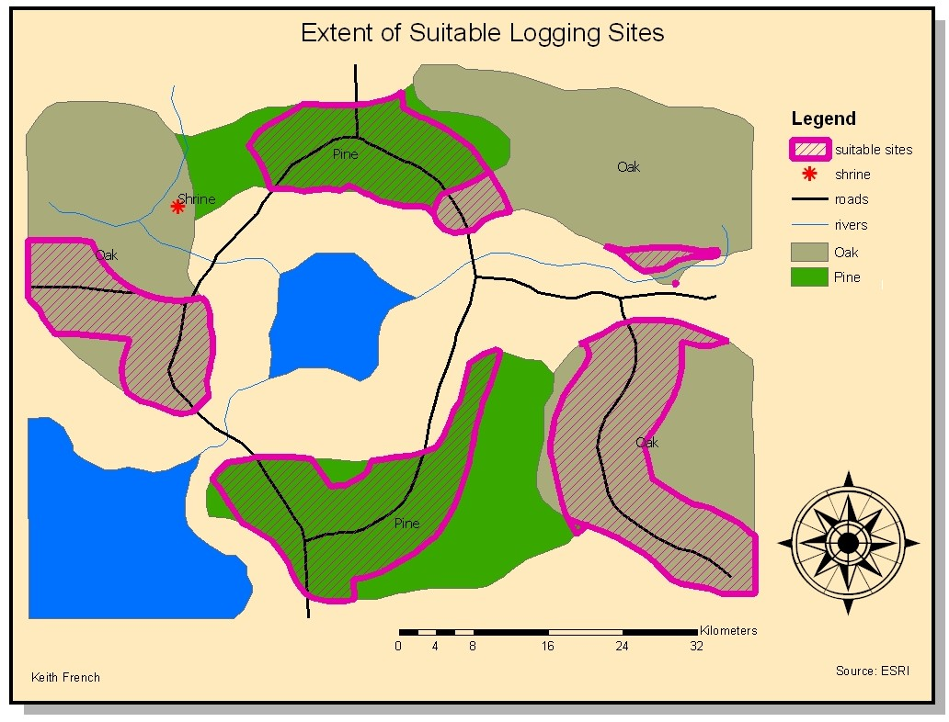
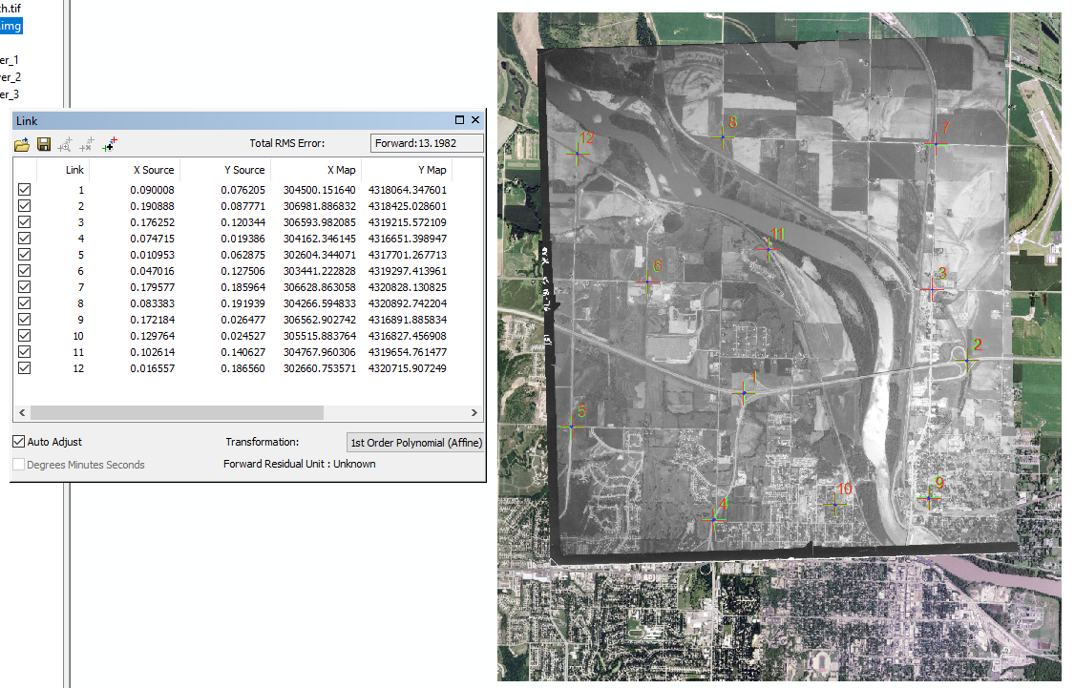
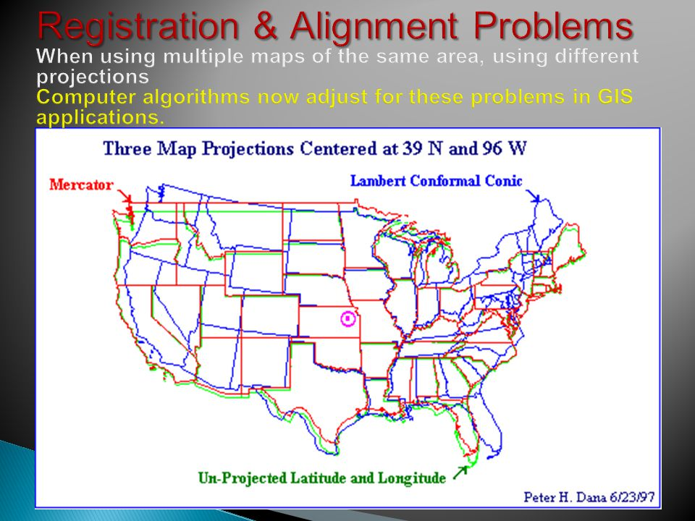
Class Thursday: GIS Review
Key Labs are on BB
I will be available to help walk through them

Slide 25


